Slide 1



Office 365 PnP Transformation – Solution Design Report
<Consultant Name>
<Title>
<Company Name>

Slide 2
Agenda
PnP Transformation approach
Introduction
Business drivers for the solution
Existing UI design and summary of customizations
Solution Design per scenario
Detailed description on what kind of elements will need to be implemented
Transformation effort
Details on transforming existing content and sites to the new app model based implementation
Purpose of this presentation is to clearly explain what kind of customizations are needed for the customer based on business requirements and how they will be implemented.

Slide 3
PnP Transformation approach

Slide 4
Application Modernization PnP Transformation Approach
Customer Preparedness
Solution Assessment
Architecture Session
STEP 1
Empower & Plan
App hosting configuration. Leverage available resources to ramp up dev resources
Analyze solution inventory / requirements and provide guidance on solution modernization
Provide architecture design guidance for selected scenarios
Deliverable:
Successful smoke test app to validate configuration
Deliverable:
Assessment report
Deliverable:
Architecture Design Report
Development SOW (optional)
Development & Testing
Deployment
STEP 2
Develop & Deploy
Jointly work on development and testing with MS partners
Retract FTC
Deploy App solutions
Deliverable:
Tested solution artifacts
Deployment Guide
Deliverable:
Replace FTC by APP
Project signoff
Notes:
FTC: Full Trust Code
SOW: Statement of Work

Slide 5
Architecture Session
Provide architecture design guidance for selected scenarios. Results in an architecture design report and provides basis for Development estimate
Engagement Criteria | Roles & Responsibilities |  | Deliverable
 | Customer | MS Partner
Final solution requirement document FTC to APP Assessment report Existing solution demo | Solution design proposal Drive final solution design creation | Architecture Design Workshop Possible Proof of Concepts | Architecture Design report Development SOW (Optional)
Module Overview
Technical planning support Day 2-3
Kickoff
Everybody
Scenario walkthrough
Technical support
Reference code and POC
Solution design assistance
Report and Stakeholder presentation
Next steps
Startup Day 1
Finalization Day 4-5
Developers
Everybody
Stage
Audience
Notes:
Architecture Design Session to review requirements and jointly design the app solutions.

Slide 6
Overview

Slide 7
Background information
High level summary on the portal and what is included

Slide 8
Business drivers
Business drivers of the solution. High level definition of the business requirements

Slide 9
Applications
Collaboration
URL:
Content:
Portal
URL:
Content:
My Site
URL:
Content:
Partners
URL:
Content:
Introduction to existing applications in the Dedicated farm. What is in use and what do they contain. Could be multiple slides

Slide 10





Current UI for team sites
Web page title
http://www.url.com
Collaboration site UI. Could consist from multiple slides with screen shots. Purpose is to show the different sides and customizations in existing team sites.

Slide 11
Current UI for portal
Web page title
http://www.url.com
Portal or Intranet UI with different layouts. Could be multiple slides with multiple pictures showing different layouts and functionalities in the portal application

Slide 12
Current UI for my site
Web page title
http://www.url.com
UI for my site.

Slide 13
vNext transition plan status
Details on the current status with the vNext transition. What are the plans and high level schedule or target to achieve the transition.

Slide 14
General architecture

Slide 15
Network design
Where will the apps be hosted in short term and optionally in long term. Definitions of the needed environments and hosting requirements

Slide 16
Hosting environment details
Where will the apps be hosted in short term and optionally in long term. Definitions of the needed environments and hosting requirements

Slide 17
High level solution architecture
High level logical solution design. Elements and individual provider hosted apps with specified URLs.

Slide 18
SAML usage design
Possible notes on SAML usage. Slide can be deleted if SAML is not in use.

Slide 19
Provisioning
Provisioning details: what are provisioned and how. How the site provisioning is created and what kind of templates will exists in the solution.

Slide 20
Site provisioning
Administrative driven provisioning
Self service site collection provisioning

Slide 21
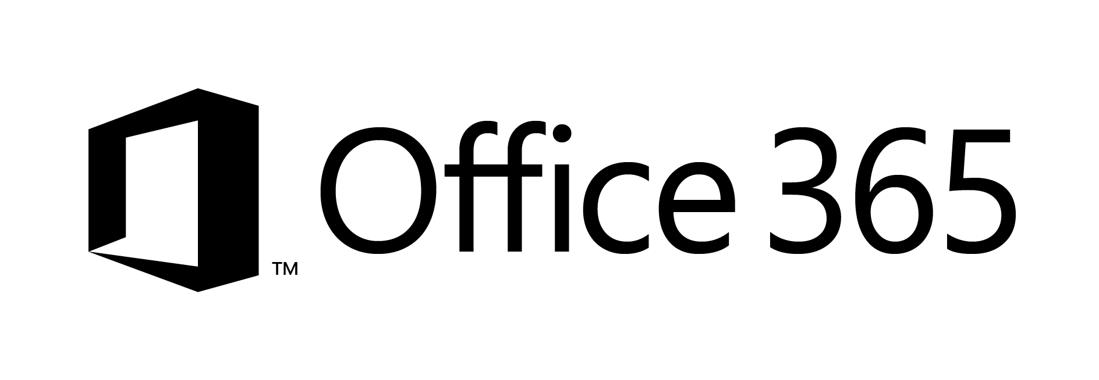

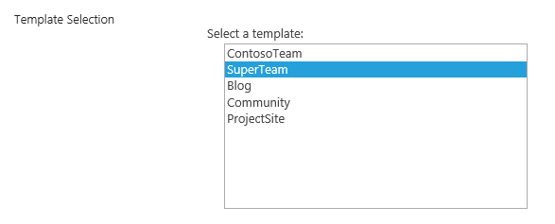
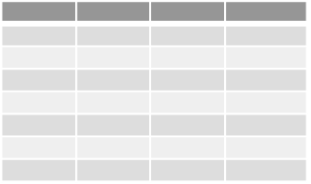
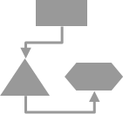
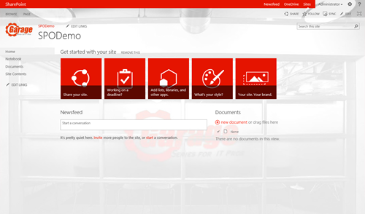

Provisioning logic
1
2
CSOM/REST
CSOM/REST
3
C#
Assets and configuration
Remote Timer job
CSOM/REST
4
Branding Images
Master Pages
Page Layouts
Other settings
5

Slide 22
Sub site provisioning
As part of the provisioning sub site

Slide 23
Branding
What kind of branding solutions are needed. Identity needed branding model from themes, custom css, master pages, page layouts. Specific solutions for branding management.

Slide 25
UX Components
UX component handling. For example replacement of web or delegate controls in old master pages . Other elements which are needed for the solution.

Slide 27
Search
Implementation details for the search from UI perspective. Specific customizations and possible apps based on search technologies.

Slide 29
Composites and business apps
Any business applications or composite apps which could be converted as specific apps. Includes possible conversion plan for server side workflows or timer jobs.

Slide 31
Profile
Profile customizations including custom attribute replication to Office 365 from AD or user interface capabilities dependent on the user profile properties.

Slide 32
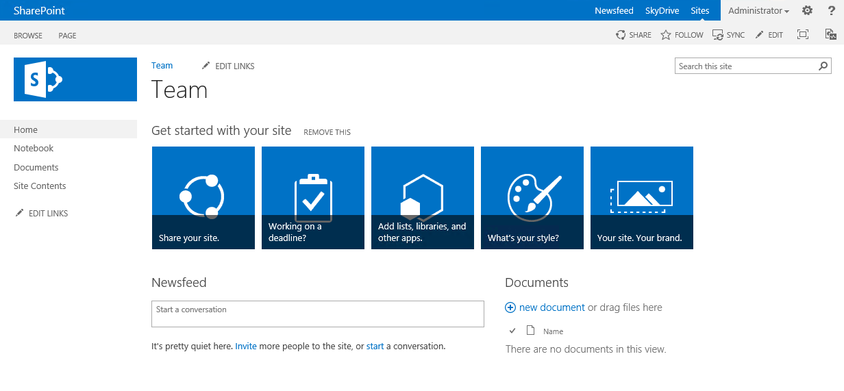
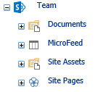
User profile sync and usage process
1
Customer
Active Directory
3
2
4
Custom synchronization tool
Functionalities can use the user profile properties to show information or to change the end user experience.
Notes:
With Office365, standard set of AD attributes are replicated to the Office365. This replication cannot be modified in cloud, but it can be modified in on-premises
In case of Office365, if you have requirement for additional user attributes, separate customized synchronization tool is needed
In case of Office365, separate tool has to be responsible of replicating the user profile information to the cloud
User profile information can be used to present information or for example to alter the end user experience based on the user profile attribute. Most simplified example would be to show for example weather based on the office location of the user, which is available from user profile.

Slide 33
Custom user profile properties

Slide 34
User profile drive UI elements

Slide 35
WCM
WCM capabilities which should be converted to app model side. Focus on the page layouts, possible existing field controls and how those are handled.

Slide 37
ECM
ECM capabilities which should be noted. Resolution plan for existing capabilities to the app model side. Could be also things which will be dropped due lack of capability in app model side.

Slide 39
Other
Other customizations in FTC which need to be converted to the app model implementation. Whatever does not fall into above scenarios.

Slide 41
Content transformation process
Model and pattern how to convert existing site collections which have been created using FTC to the app model implementation to enable retraction of the wsp package.

Slide 42
Transformation process
Actual details on how the transition is completed, including necessary tooling which is used for the conversion process.

Slide 43
Transformation process options
In-place
Use out of box features
Swing/Migration
Use APP model techniques

Slide 44

Questions?

Slide 45


© 2014 Microsoft Corporation. All rights reserved. Microsoft, Windows, and other product names are or may be registered trademarks and/or trademarks in the U.S. and/or other countries.
The information herein is for informational purposes only and represents the current view of Microsoft Corporation as of the date of this presentation. Because Microsoft must respond to changing market conditions, it should not be interpreted to be a commitment on the part of Microsoft, and Microsoft cannot guarantee the accuracy of any information provided after the date of this presentation. MICROSOFT MAKES NO WARRANTIES, EXPRESS, IMPLIED OR STATUTORY, AS TO THE INFORMATION IN THIS PRESENTATION.

